Slide 1


SHAQRA UNIVERSITY
College of Computing and Information Technology
Programming Language (2)
CSC 213
File Handling in python programming

Slide 2


» Introduction to Files
» Types of Files
» Opening and Closing a Text File
» Writing to a Text File
» Reading from a Text File
» Setting Offsets in a File
» Creating and Traversing a Text File
» The Pickle Module

Slide 3
4.1 INTRODUCTION TO FILES
We have so far created programs in Python that accept the input, manipulate it and display the output. But that output is available only during execution of the program and input is to be entered through the keyboard.
This is because the variables used in a program have a lifetime that lasts till the time the program is under execution.
What if we want to store the data that were input as well as the generated output permanently so that we can reuse it later?
Usually, organisations would want to permanently store information about employees, inventory, sales, etc. to avoid repetitive tasks of entering the same data.
Hence, data are stored permanently on secondary storage devices for reusability.
We store Python programs written in script mode with a .py extension. Each program is stored on the secondary device as a file. Likewise, the data entered, and the output can be stored permanently into a file.

Slide 4
4.2. TYPES OF FILES
So, what is a file? A file is a named location on a secondary storage media where data are permanently stored for later access.
Computers store every file as a collection of 0s and 1s i.e., in binary form. Therefore, every file is basically just a series of bytes stored one after the other.
There are mainly two types of data files — text file and binary file.
A text file consists of human readable characters, which can be opened by any text editor.
On the other hand,
binary files are made up of non-human readable characters and symbols, which require specific programs to access its contents.

Slide 5
4.2.1 Text file
A text file can be understood as a sequence of characters consisting of alphabets, numbers and other special symbols.
Files with extensions like .txt, .py, .csv, etc. are some examples of text files.
When we open a text file using a text editor (e.g., Notepad), we see several lines of text.
However, the file contents are not stored in such a way internally. Rather, they are stored
in sequence of bytes consisting of 0s and 1s.
In ASCII, UNICODE or any other encoding scheme, the value of each character of the text file is stored as bytes. So, while opening a text file, the text editor translates each ASCII value and shows us the equivalent character that is readable by the human being.
For example, the ASCII value 65 (binary equivalent 1000001) will be displayed by a text editor as the letter ‘A’ since the number 65 in ASCII character set represents ‘A’

Slide 6
4.2.2 Binary file
Binary files are also stored in terms of bytes (0s and 1s),
but unlike text files, these bytes do not represent the ASCII values of characters.
Rather, they represent the actual content such as image, audio, video, compressed versions of other files, executable files, etc.
These files are not human readable.
Thus, trying to open a binary file using a text editor will show some garbage values. We need specific software to read or write the contents of a binary file.
Binary files are stored in a computer in a sequence of bytes.
Even a single bit change can corrupt the file and make it unreadable to the supporting application. Also, it is difficult to remove any error which may occur in the binary file as the stored contents are not human readable.
We can read and write both text and binary files through Python programs.

Slide 7
Most of the files that we see in our computer system are called binary files.
Example:
Document files: .pdf, .doc, .xls etc.
Image files: .png, .jpg, .gif, .bmp etc.
Video files: .mp4, .3gp, .mkv, .avi etc.
Audio files: .mp3, .wav, .mka, .aac etc.
Database files: .mdb, .accde, .frm, .sqlite etc.
Archive files: .zip, .rar, .iso, .7z etc.
Executable files: .exe, .dll, .class etc.
For Example, You need Microsoft word software to open .doc binary files. Likewise, you need a pdf reader software to open .pdf binary files and you need a photo editor software to read the image files and so on.

Slide 8


Slide 9
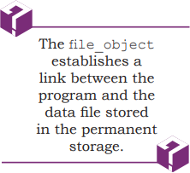
4.3 OPENING AND CLOSING A TEXT FILE
Operations on files include creating and opening a file, writing data in a file, traversing a file, reading data from a file and so on.
Python has the io module that contains different functions for handling files.
Opening a file
To open a file in Python, we use the open() function.
The syntax of open() is as follows:
File_object = open(file_name, access_mode)
The file_object has certain attributes that tells us basic information about the file, such as:
<file.closed> returns true if the file is closed and false otherwise.
<file.mode> returns the access mode in which the file was opened.
<file.name> returns the name of the file.

Slide 10

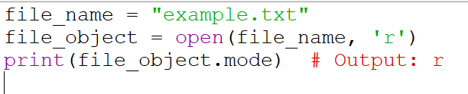
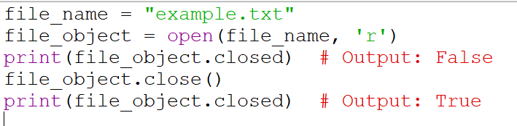

Slide 11

File_object = open(file_name, access_mode)
The file_name should be the name of the file that has to be opened.
If the file is not in the current working directory, then we need to specify the complete path of the file along with its name.
The access_mode is an optional argument that represents the mode in which the file
has to be accessed by the program. It is also referred to as processing mode.
Here mode means the operation for which the file has to be opened like
<r> for reading,
<w> for writing,
<+> for both reading and writing,
<a> for appending at the end of an existing file.
The default is the read mode.

Slide 12
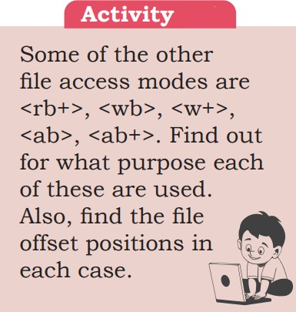

Slide 13
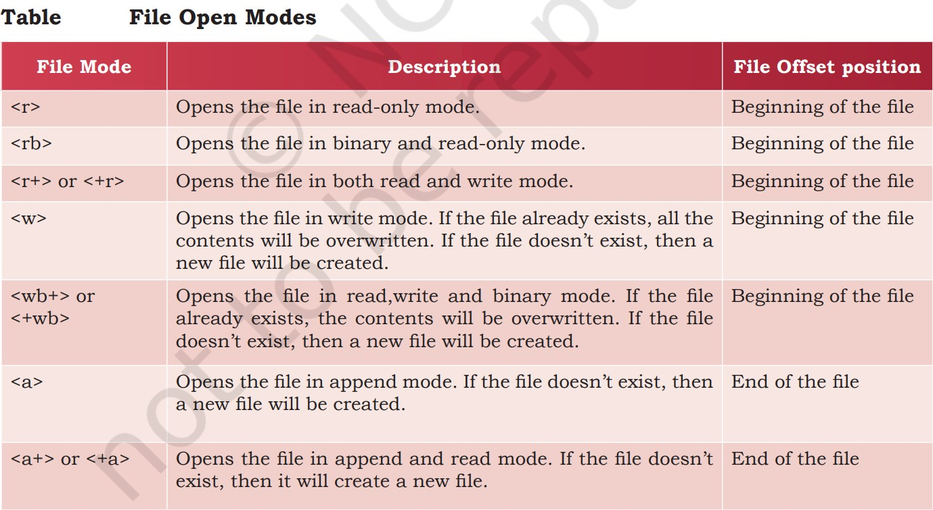

Slide 14
Consider the following example.
myObject=open(“myfile.txt”, “a+”)
In the above statement, the file myfile.txt is opened in append and read modes.
The file object will be at the end of the file.
That means we can write data at the end of the file and at the same time we can also read data from the file using the file object named myObject.

Slide 15
4.3.2 Closing a file
Once we are done with the read/write operations on a file, it is a good practice to close the file.
Python provides a close() method to do so. While closing a file, the system
frees the memory allocated to it. The syntax of close() is:
file_object.close()
Here, file_object is the object that was returned while opening the file.
Python makes sure that any unwritten or unsaved data is flushed (written) to the file
before it is closed. Hence, it is always advised to close the file once our work is done.

Slide 16
4.3.3 Opening a file using with clause
The syntax of with clause is:
with open(file_name, access_mode) as file_ object:
The advantage of using with clause is that any file that is opened using this clause is closed automatically, once the control comes outside the with clause.
In case the user forgets to close the file explicitly or if an exception occurs, the file is
closed automatically. Also, it provides a simpler syntax.
with open(“myfile.txt”,”r+”) as myObject: content = myObject.read()
Here, we don’t have to close the file explicitly using close() statement. Python will automatically close the file.

Slide 17
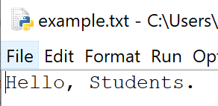
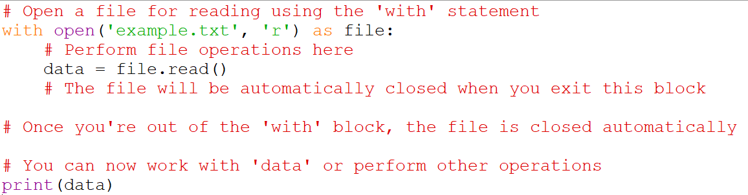
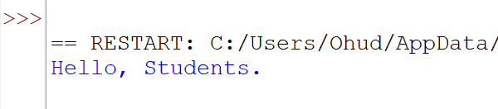

Slide 18
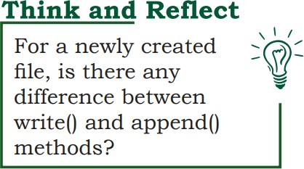
4.4 WRITING TO A TEXT FILE
For writing to a file, we first need to open it in write or append mode.
If we open an existing file in write mode, the previous data will be erased, and the file object will be positioned at the beginning of the file.
On the other hand, in append mode, new data will be added at the end of the previous data as the file object is at the end of the file.
After opening the file, we can use the following methods to write data
in the file.
write() - for writing a single string
writelines() - for writing a sequence of strings

Slide 19
4.4.1 The write() method
write() method takes a string as an argument and writes it to the text file. It returns the number of characters being written on single execution of the write() method. Also, we need to add a newline character (\n) at the end of every sentence to mark the end of line.
Consider the following piece of code:
>>> myobject=open("myfile.txt",'w')
>>> myobject.write("Hey I have started #using files in Python\n")
41
>>> myobject.close()
On execution, write() returns the number of characters written on to the file. Hence, 41, which is the length of the string passed as an argument, is displayed.
Note: ‘\n’ is treated as a single character

Slide 20
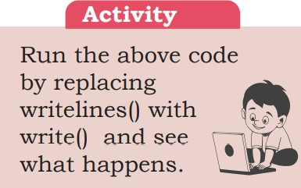
If numeric data are to be written to a text file,
the data need to be converted into string before writing to the file.
For example:
>>>myobject=open("myfile.txt",'w')
>>> marks=58
#number 58 is converted to a string using #str()
>>> myobject.write(str(marks))
2
>>>myobject.close()
The write() actually writes data onto a buffer.
When the close() method is executed, the contents from this buffer are
moved to the file located on the permanent storage.

Slide 21
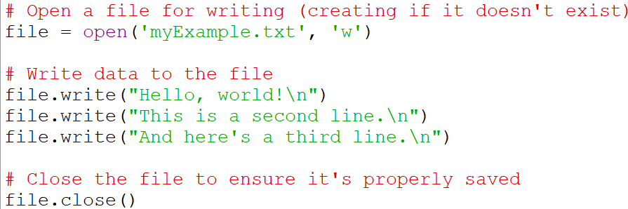
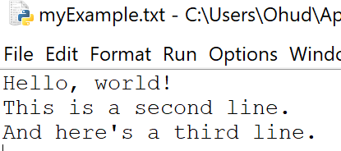

Slide 22
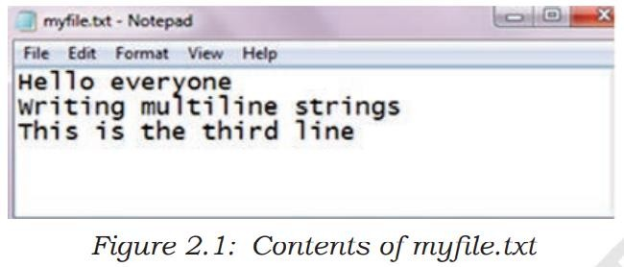
4.4.2 The writelines() method
This method is used to write multiple strings to a file.
We need to pass an iterable object like lists, tuple, etc. containing strings to the writelines()method.
Unlike write(), the writelines() method does not return the number of
characters written in the file.
The following code explains the use of writelines().
>>> myobject=open("myfile.txt",'w')
>>> lines = ["Hello everyone\n", "Writing #multiline strings\n", "This is the #third line"]
>>> myobject.writelines(lines)
>>> myobject.close()
On opening myfile.txt, using notepad, its content will appear as shown in Figure 2.1.

Slide 23
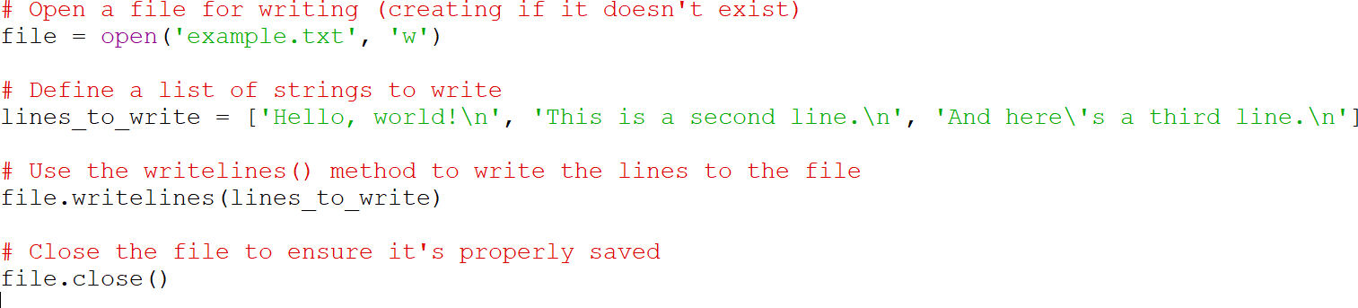
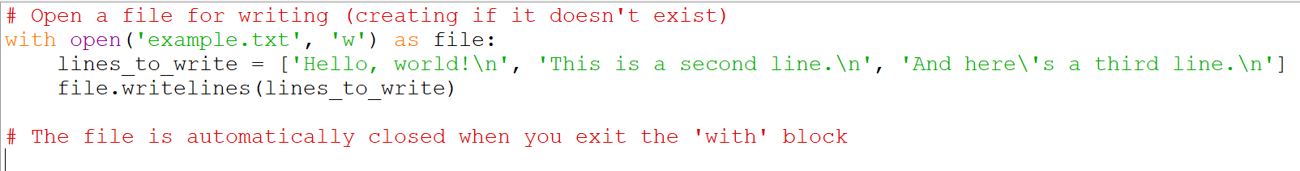
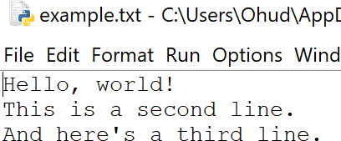

Slide 24
4.5 READING FROM A TEXT FILE
Before reading a file, we must make sure that the file is opened in “r”, “r+”, “w+” or “a+” mode.
There are three ways to read the contents of a file:
4.5.1 The read() method
This method is used to read a specified number of bytes of data from a data file.
The syntax of read() method is:
file_object.read(n)
Consider the following set of statements to understand the usage of read() method:
>>> myobject=open("myfile.txt",'r')
>>> myobject.read(10) 'Hello ever'
>>> myobject.close()

Slide 25
If no argument or a negative number is specified in read(),
the entire file content is read.
For example,
>>> myobject=open("myfile.txt",'r')
>>> print(myobject.read())
Hello everyone
Writing multiline strings This is the third line
>>> myobject.close()

Slide 26
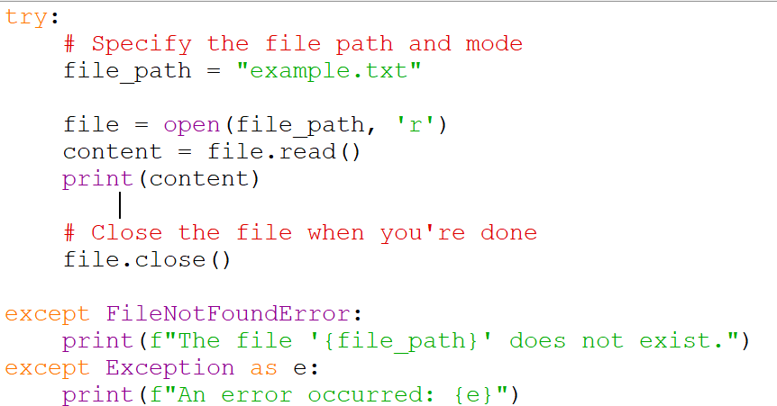
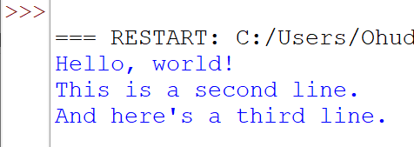
File ‘example.txt is Exist’

Slide 27
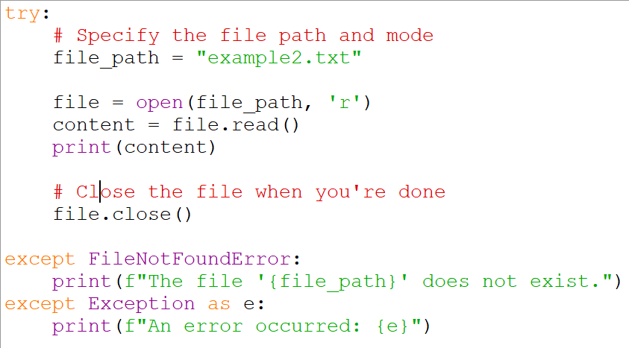

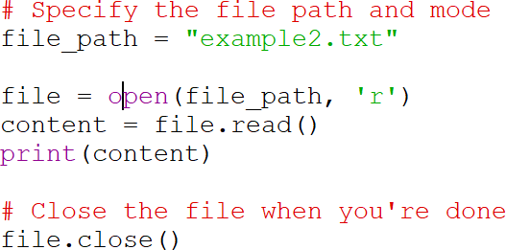
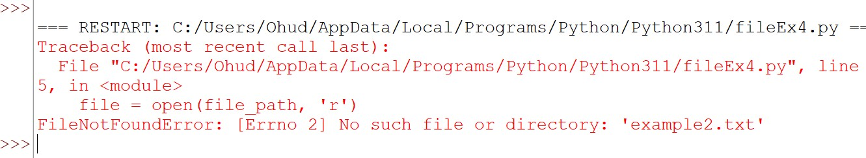
File ‘example2.txt is NOT Exist’

Slide 28
4.5.2 The readline([n]) method
This method reads one complete line from a file where each line terminates with a newline (\n) character.
It can also be used to read a specified number (n) of bytes of data from a file but maximum up to the newline character (\n).

Slide 29
In the following example,
the second statement reads the first ten characters of the first line of the text file
and displays them on the screen.
>>> myobject=open("myfile.txt",'r')
>>> myobject.readline(10) 'Hello ever'
>>> myobject.close()
If no argument or a negative number is specified,
it reads a complete line and returns string.
>>>myobject=open("myfile.txt",'r')
>>> print (myobject.readline())
'Hello everyone\n'
To read the entire file line by line using the readline(), we can use a loop. This process is known as looping/ iterating over a file object. It returns an empty string when End Of File (EOF) is reached.

Slide 30
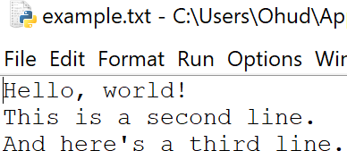
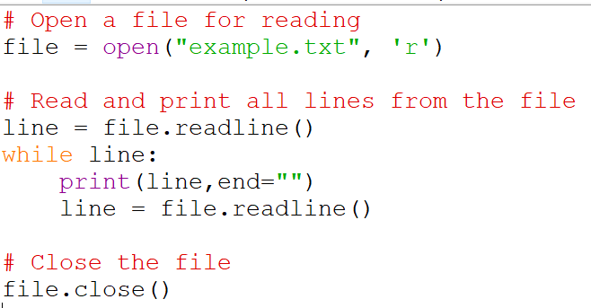
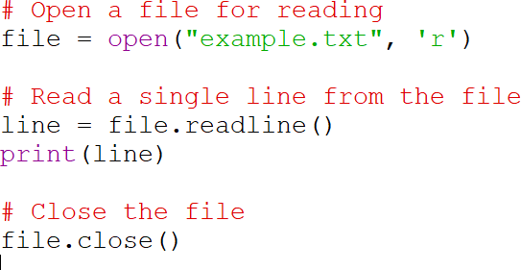
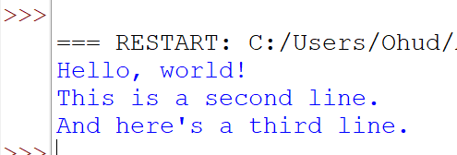
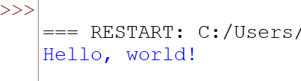
File
‘example.txt’
Output
Output

Slide 31
4.5.2 The readlines method
The method reads all the lines and returns the lines along with newline as a list of strings.
>>> myobject=open("myfile.txt", 'r')
>>> print(myobject.readlines())
['Hello everyone\n', 'Writing multiline strings\n',
'This is the third line']
>>> myobject.close()
As shown in the above output,
when we read a file using readlines() function, lines in the file become
members of a list,
where each list element ends with a newline character (‘\n’).

Slide 32
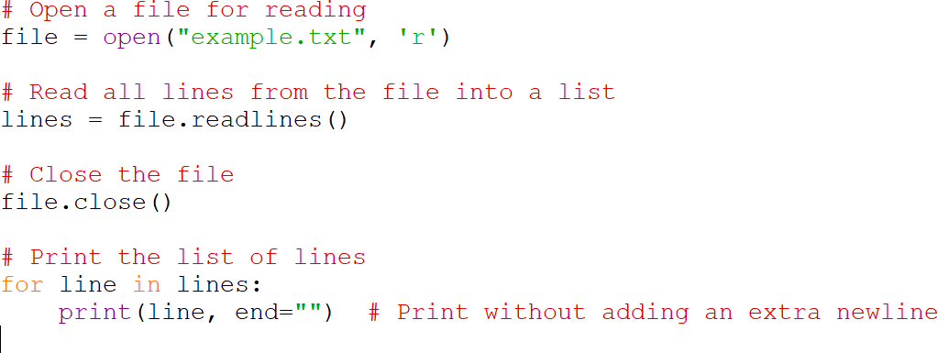
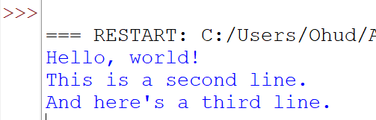
File
‘example.txt’
Output

Slide 33
In case we want to display each word of a line separately as an element of a list,
then we can use split() function.
The following code demonstrates the use of split() function.
>>> myobject=open("myfile.txt",'r')
>>> d=myobject.readlines()
>>> for line in d:
words=line.split() print(words)
['Hello', 'everyone']
['Writing', 'multiline', 'strings']
['This', 'is', 'the', 'third', 'line']
In the output, each string is returned as elements of a list.

Slide 34
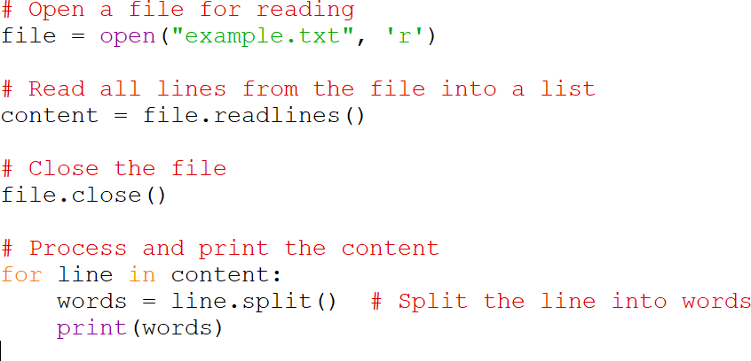
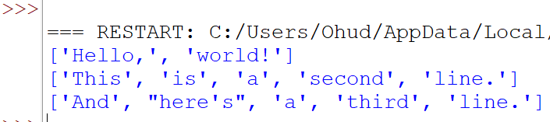
File
‘example.txt’
Output

Slide 35
However, if splitlines() is used instead of split(),
then each line is returned as element of a list,
as shown in the output below:
>>> for line in d:
words=line.splitlines() print(words)
['Hello everyone']
['Writing multiline strings']
['This is the third line']

Slide 36
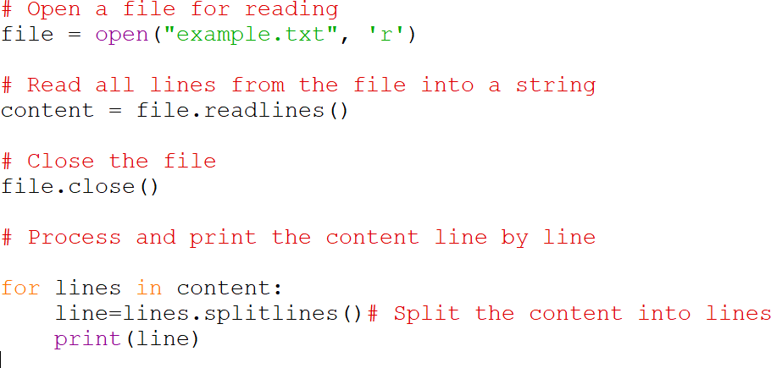
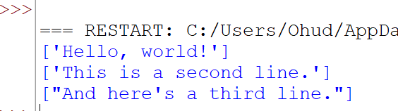
File
‘example.txt’
Output

Slide 37
Let us now write a program that accepts a string from the user and writes it to a text file.
Thereafter, the same program reads the text file and displays it on the screen.

Slide 38
Program 4-1 Writing and reading to a text file
fobject=open("testfile.txt","w") # creating a data file sentence=input("Enter the contents to be written in the file: ")
fobject.write(sentence)
fobject.close()
# Writing data to the file
# Closing a file
print("Now reading the contents of the file: ") fobject=open("testfile.txt","r")
#looping over the file object to read the file
for str in fobject:
print(str) fobject.close()
In Program 4.1, the file named testfile.txt is opened in write mode and the file handle named fobject is returned.
The string is accepted from the user and written in the file using write().
Then the file is closed and again opened in read mode.
Data is read from the file and displayed till the end of file is reached.

Slide 39
Output of Program 4-1:
>>>
RESTART: Path_to_file\Program2-1.py
Enter the contents to be written in the file: roll_numbers = [1, 2, 3, 4, 5, 6]
Now reading the contents of the file:
roll_numbers = [1, 2, 3, 4, 5, 6] >>>
4.6 SETTING OFFSETS IN A FILE
The functions that we have learnt till now are used to access the data sequentially from a file.
But if we want to access data in a random fashion,
then Python gives us seek() and tell() functions to do so.

Slide 40
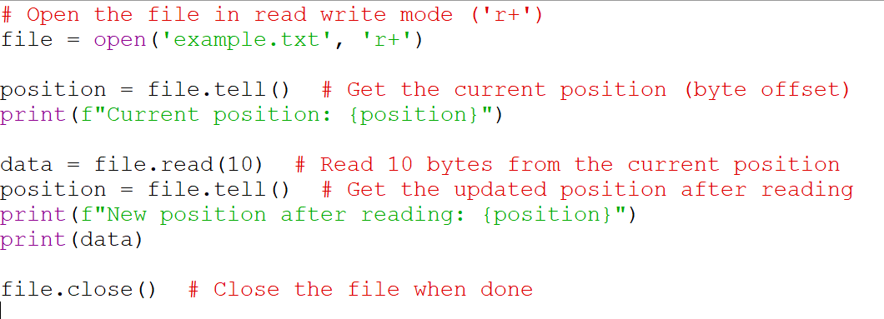
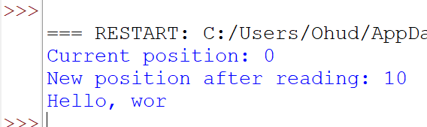
4.6.1 The tell() method
This function returns an integer
that specifies the current position of the file object in the file.
The position so specified is
the byte position from the beginning of the file till the current position of the file object.
The syntax of using tell()
is:
file_object.tell()
Output

Slide 41
4.6.2 The seek() method
This method is used to position the file object at a particular position in a file.
The syntax of seek() is:
file_object.seek(offset [, reference_point])
In the above syntax,
offset is the number of bytes by which the file object is to be moved.
reference_point indicates the starting position of the file object.
That is, with reference to which position, the offset has to be counted. the
reference point for the offset can take one of three values:
- beginning of the file
- current position of the file
- end of file
By default, the value of reference_point is 0,
i.e. the offset is counted from the beginning of the file.
For example, the statement fileObject.seek(5,0) will position the file
object at 5th byte position from the beginning of the file.

Slide 42
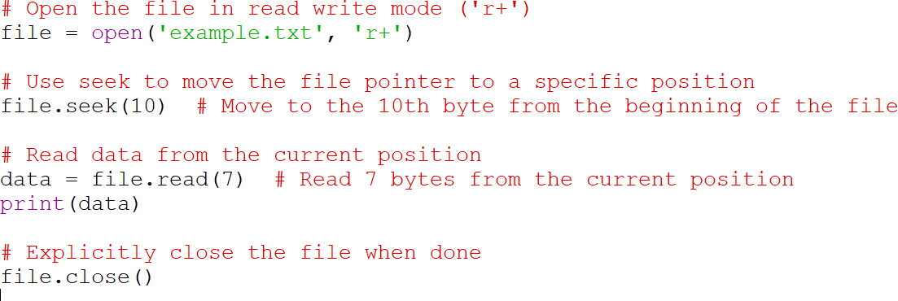
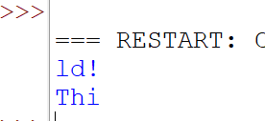
File
‘example.txt’
Output

Slide 43
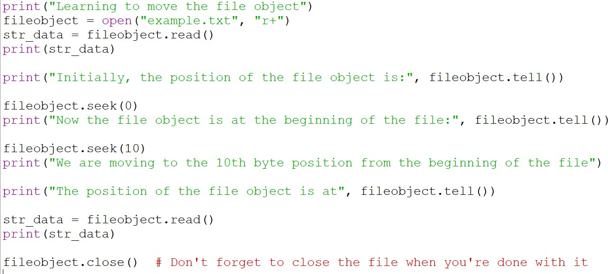
Program 4-2 Application of seek() and tell()
File ‘example.txt’

Slide 44
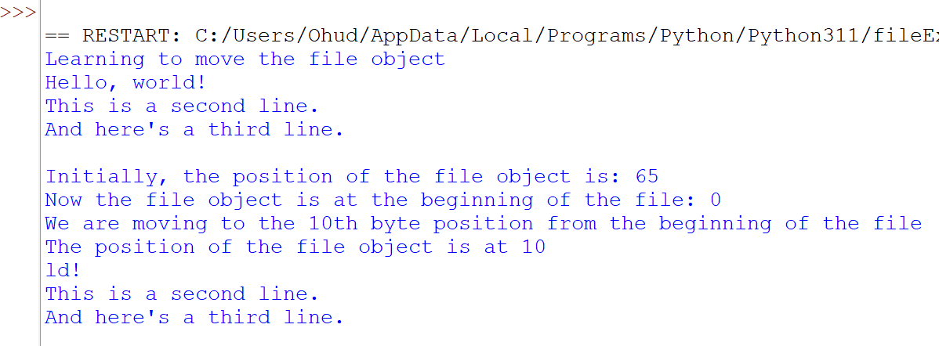
File ‘example.txt’
Output of Program

Slide 45
The End

